Slide 1
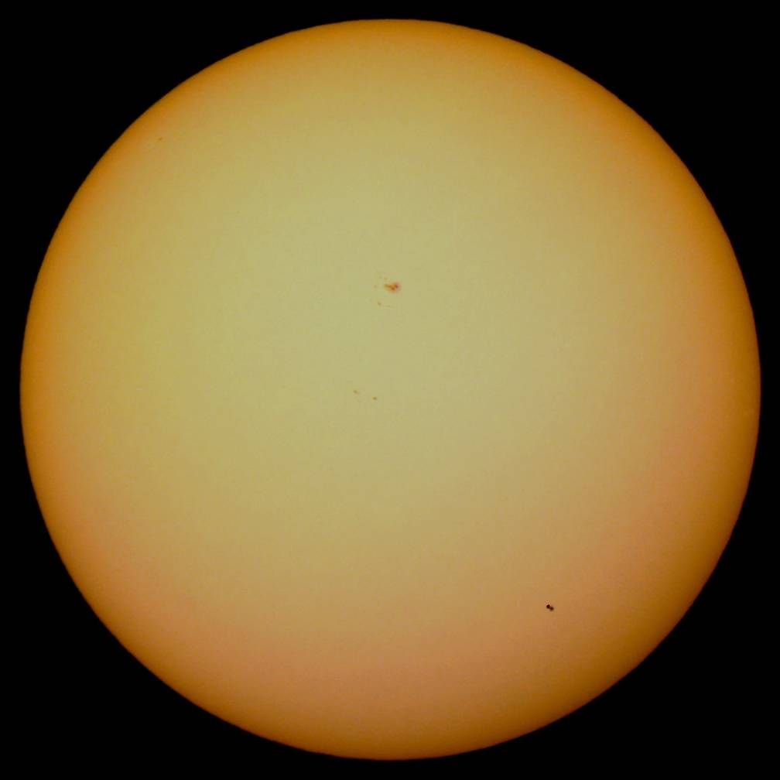
Measuring the Scale of the Solar System, through Transits of Mercury
Jay M.Pasachoff,
Williams College-Hopkins Observatory, Williamstown, Massachusetts 01267, USA
Udo Backhaus, Alfred Knülle-Wenzel
Fakultät für Physik der Universität Duisburg-Essen, 45117 Essen, Germany
Mercury‘s parallax 2016
between Big Bear Observatory (G. Schneider and J. M. Pasachoff)
and Hannover (U. Backhaus)

Slide 2
Overview
Introduction
Some theory:
Transits and the scale of the solar system
The project
“Observing, photographing and evaluating the Transit of Mercury 2019“
Results of a similar project in 2016
Call for participation

Slide 3
Introduction
On November 11th between 12:35 and 18:04 Universal Time the tiny black silhouette of Mercury will slowly pass the Sun's disc. Such a passage is called a transit of Mercury. Because Mercury's orbit around the Sun is inclined with respect to the Earth's orbit, for an observer on Earth, Mercury will usually pass above or below the Sun and will be unvisible during its conjunction with the Sun. Transits of Mercury, therefore, are quite rare (12 – 13 per century).
The 2019 transit will be the last chance until 2032 to see Mercury cross in front of the Sun and to reenact the fascination felt by astronomers in past centuries and by amateurs while observing the transits of Venus in 2004 and 2012 and of Mercury in 2016.

Slide 4
Transits and the scale of the solar system
Due to Kepler‘s third law the ratios of all planets orbital radii are known. But an absolute scale of the system could not be determined for a long time.
Following an idea of Halley the transits of Mercury and especially Venus offered the first possibilities of exact measurements of the distance between Sun and Earth, the so called astronomical unit (au). That is why the solar disc constitutes a perfect reference system for measuring effects of parallaxe.
Today, transits of these planets offer the chance to repeat an important historical measurement with modern techniques and to get an own measure of the astronomical unit.
After November the next transit of Mercury won‘t happen until 2032 – and no human living today will see another transit of Venus (2117).

Slide 5
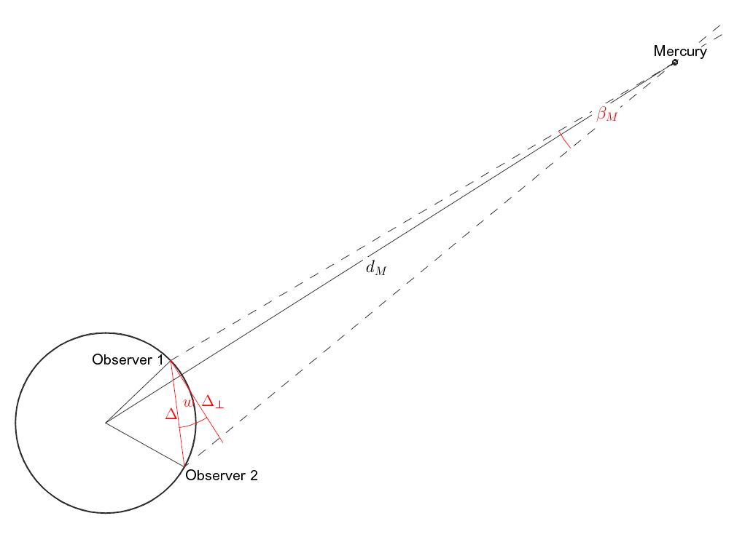

Some Theory
Measuring Mercury‘s parallax (and thereby the Sun‘s, too) during a transit can be especially exact because …
… its distance from Earth is smaller than ever,
the angle of parallax β_{M}, therefore, is especially large,
the Sun in the background forms an ideal reference system.

Slide 6


During the transit instead of Mercury‘s angle of parallax β_{M} only β_{M}-β_{S} can be measured directly.
That is why the Sun itself shows a parallactic effect
(the size of which is unknown originally).
Two photos taken simultaneously by distant observers
aligned to the stars aligned to the Sun
Provided that the ratio r_{E}/r_{M} of the Earth‘s and Mercury‘s heliocentric distances are known, the Sun‘s parallactic displacement β_{S} due to two observers with respect to the stars can be derived from Mercury‘s displacement β_{M}-β_{S} with respect to the solar disc.
Therefore, the distance d_{S} to the Sun can be derived from the distance Δ between the observers and the Sun‘s angle of parallaxe β_{S}.
β_{S}
star
-β_{S}
β_{M}
β_{M}-β_{S}
The Sun‘s and Mercury‘s parallactic displacements
β_{S} and β_{M} with respect to the stars
Mercury‘s displacement Δβ=β_{M}-β_{S} with respect to the Sun

Slide 7
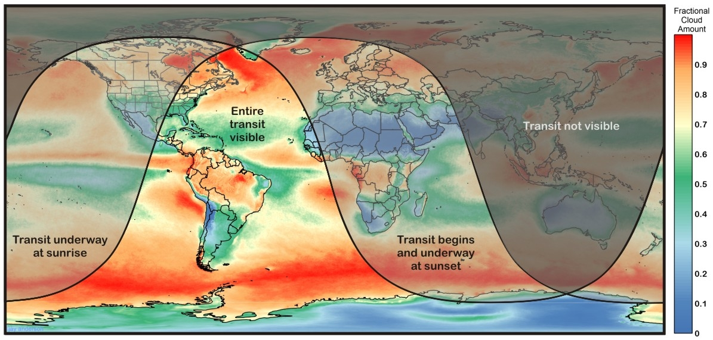
The Transit of Mercury
November 11, 2019
The transit will be visible from Europe, Africa and the American continent. But only from the eastern part of the US and Canada and from South America it will be observable from the beginning to its end.

Slide 8
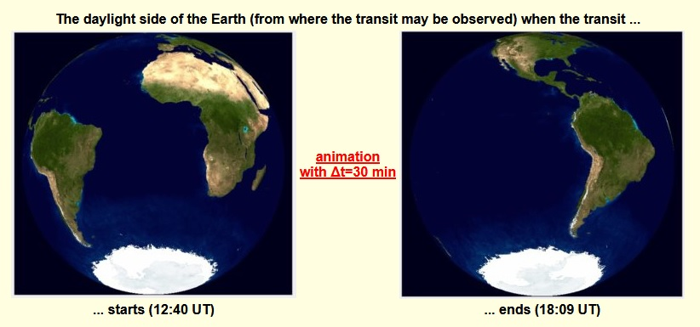
Another look to the conditions of observability

Slide 9
Essentials of the transit 2019
The transit will start at about 12:40 UTC and end at 18:09 UTC.
The distances of the Sun and Mercury will be d_{S}=0.9900 au and d_{M}=0.6757 au. Their parallaxes, therefore, will be π_{S}=8.88“ and π_{M}=13.01“.
Mercury‘s parallactic shift with respect to the Sun will be smaller than 4.1“, that is about 40% of its angular diameter.
To measure this tiny effect it will be essential to get pictures taken exactly at the same time by observers who are as widely seperated as possible.
For getting a satisfying measure of the distance to the Sun it will be essential to determine the orientation of the images as exactly as possible.

Slide 10
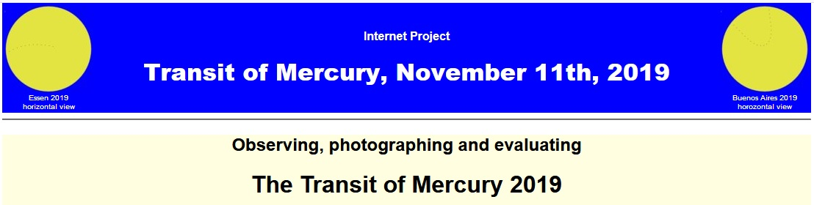
www.transit-of-mercury2019.de
We try to bring together observers from the entire region of visibility and to animate them to take pictures at times appointed in advance.
The images will be collected on the project sites, enabling comparisons between simultaneously taken pictures.
Algorithms and utilities for evaluations will be offered.

Slide 11
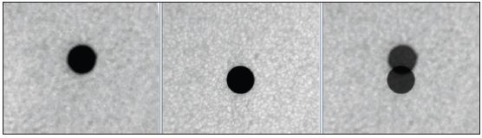
In 2016 we organized a similar transit project.
Some of its results:
J. M. Pasachoff (at Big Bear Solar Observatory, BBSO, in California) and B. Gährken, (Bayerische Volkssternwarte München) photographed Mercury over the solar photosphere and aligned the images using the solar granulation.
Weiden, Germany BBSO aligned by correlating
patterns of the granulation
The evaluation of the combined picture yields a solar parallax of 8.68“ or a solar distance of d_{S}=151.9 million km, which is only about 0.5% greater than the actual distance.

Slide 12
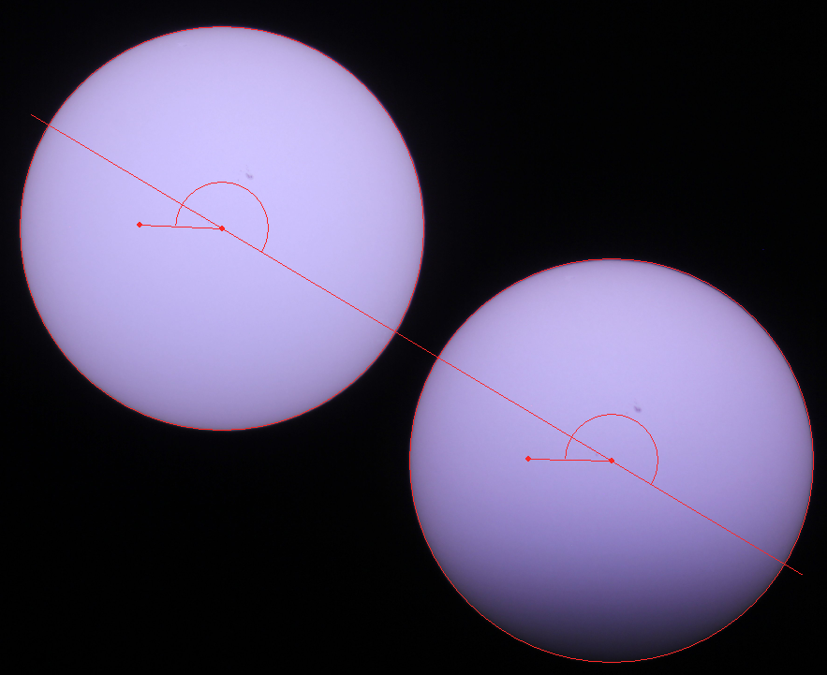
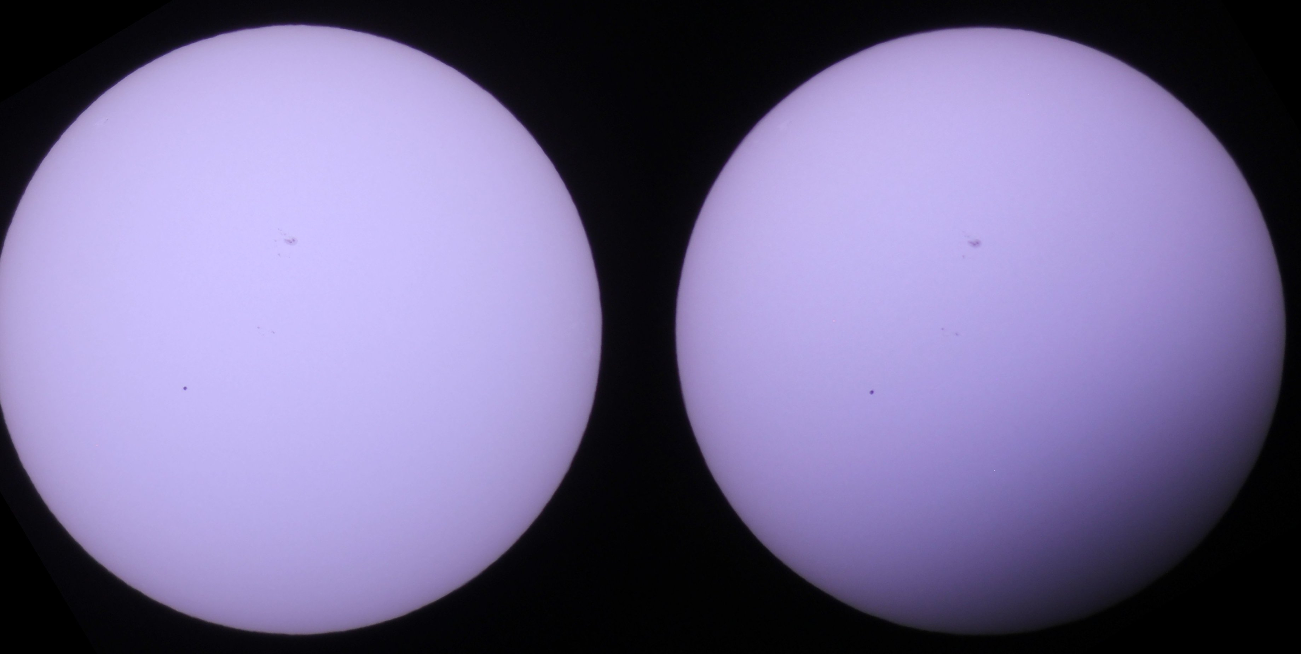
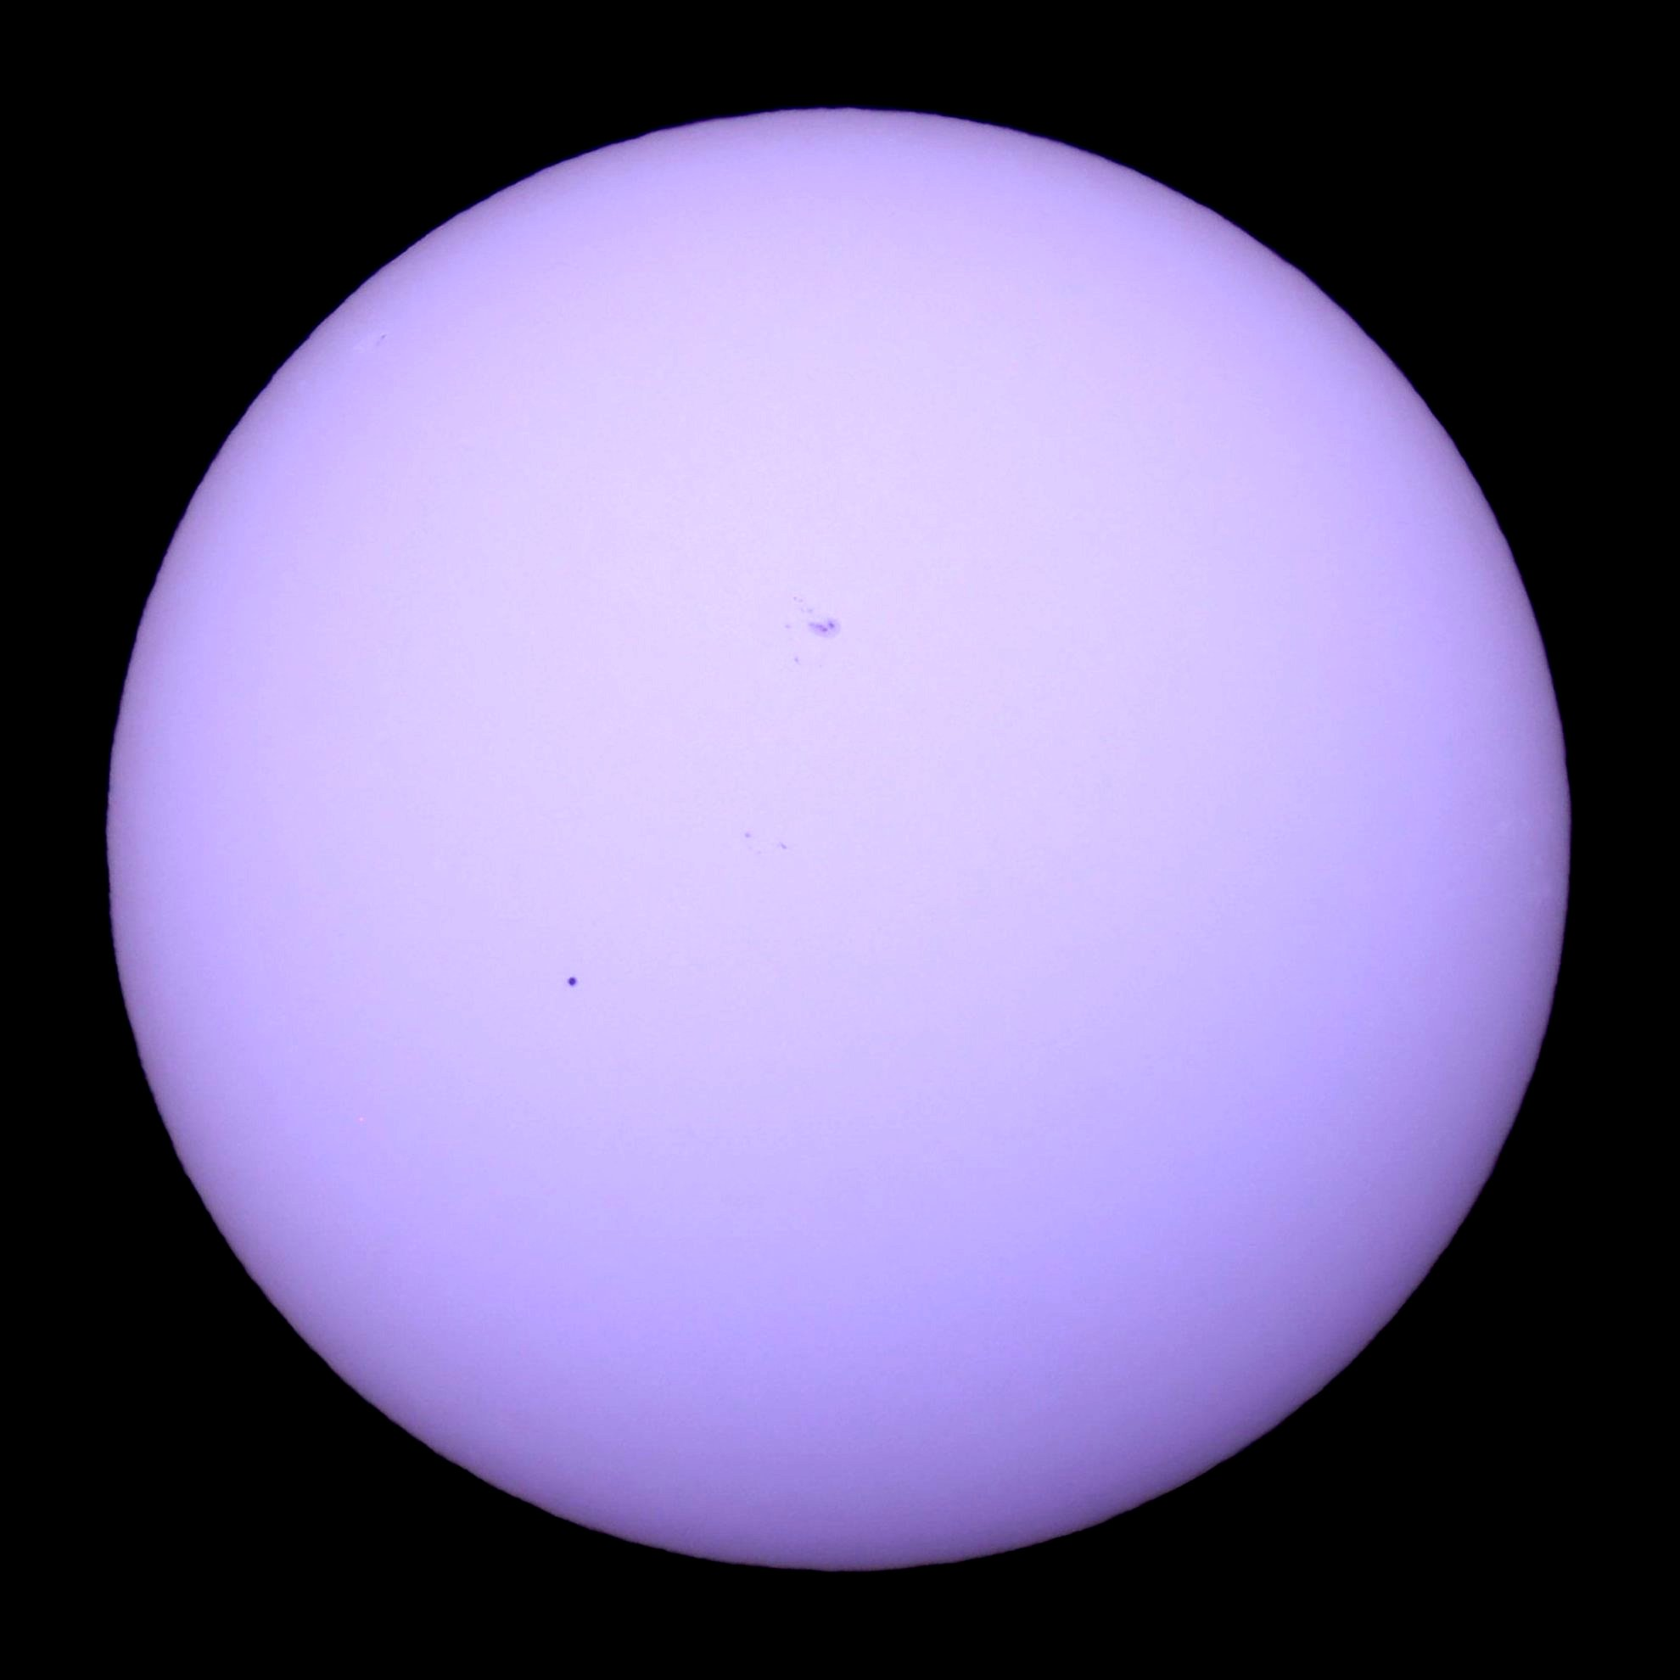
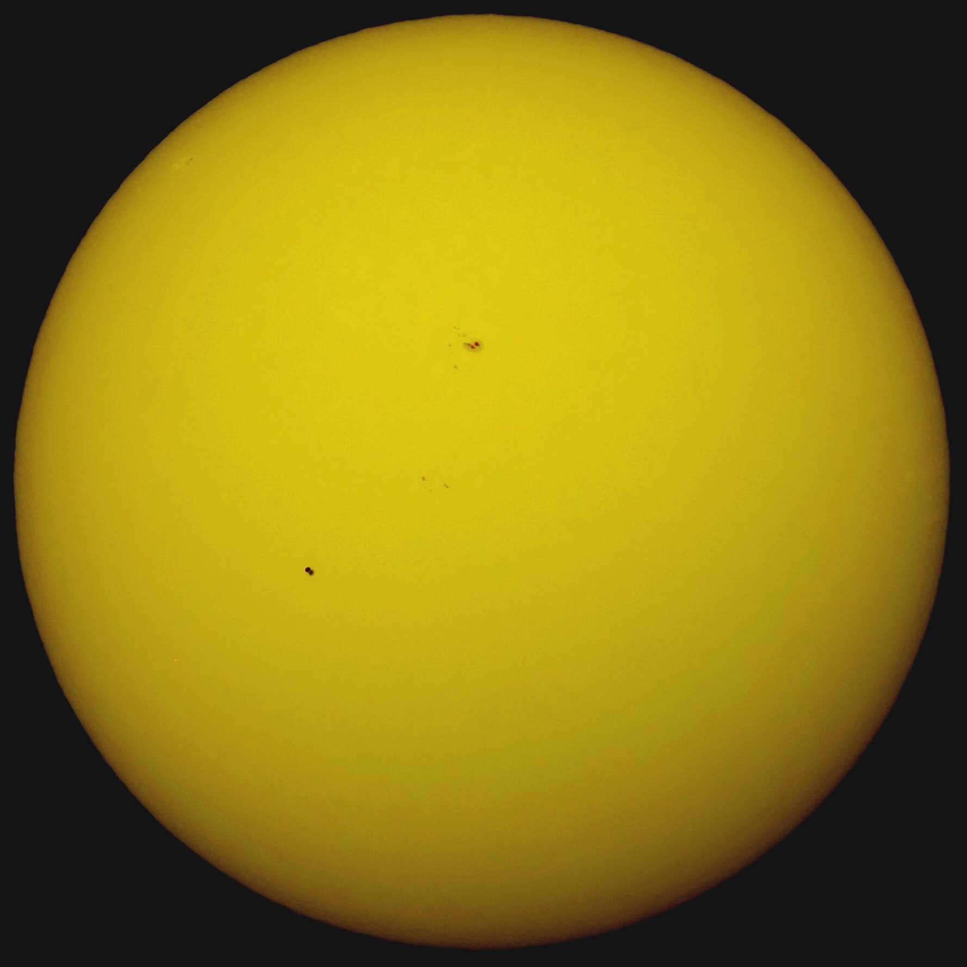
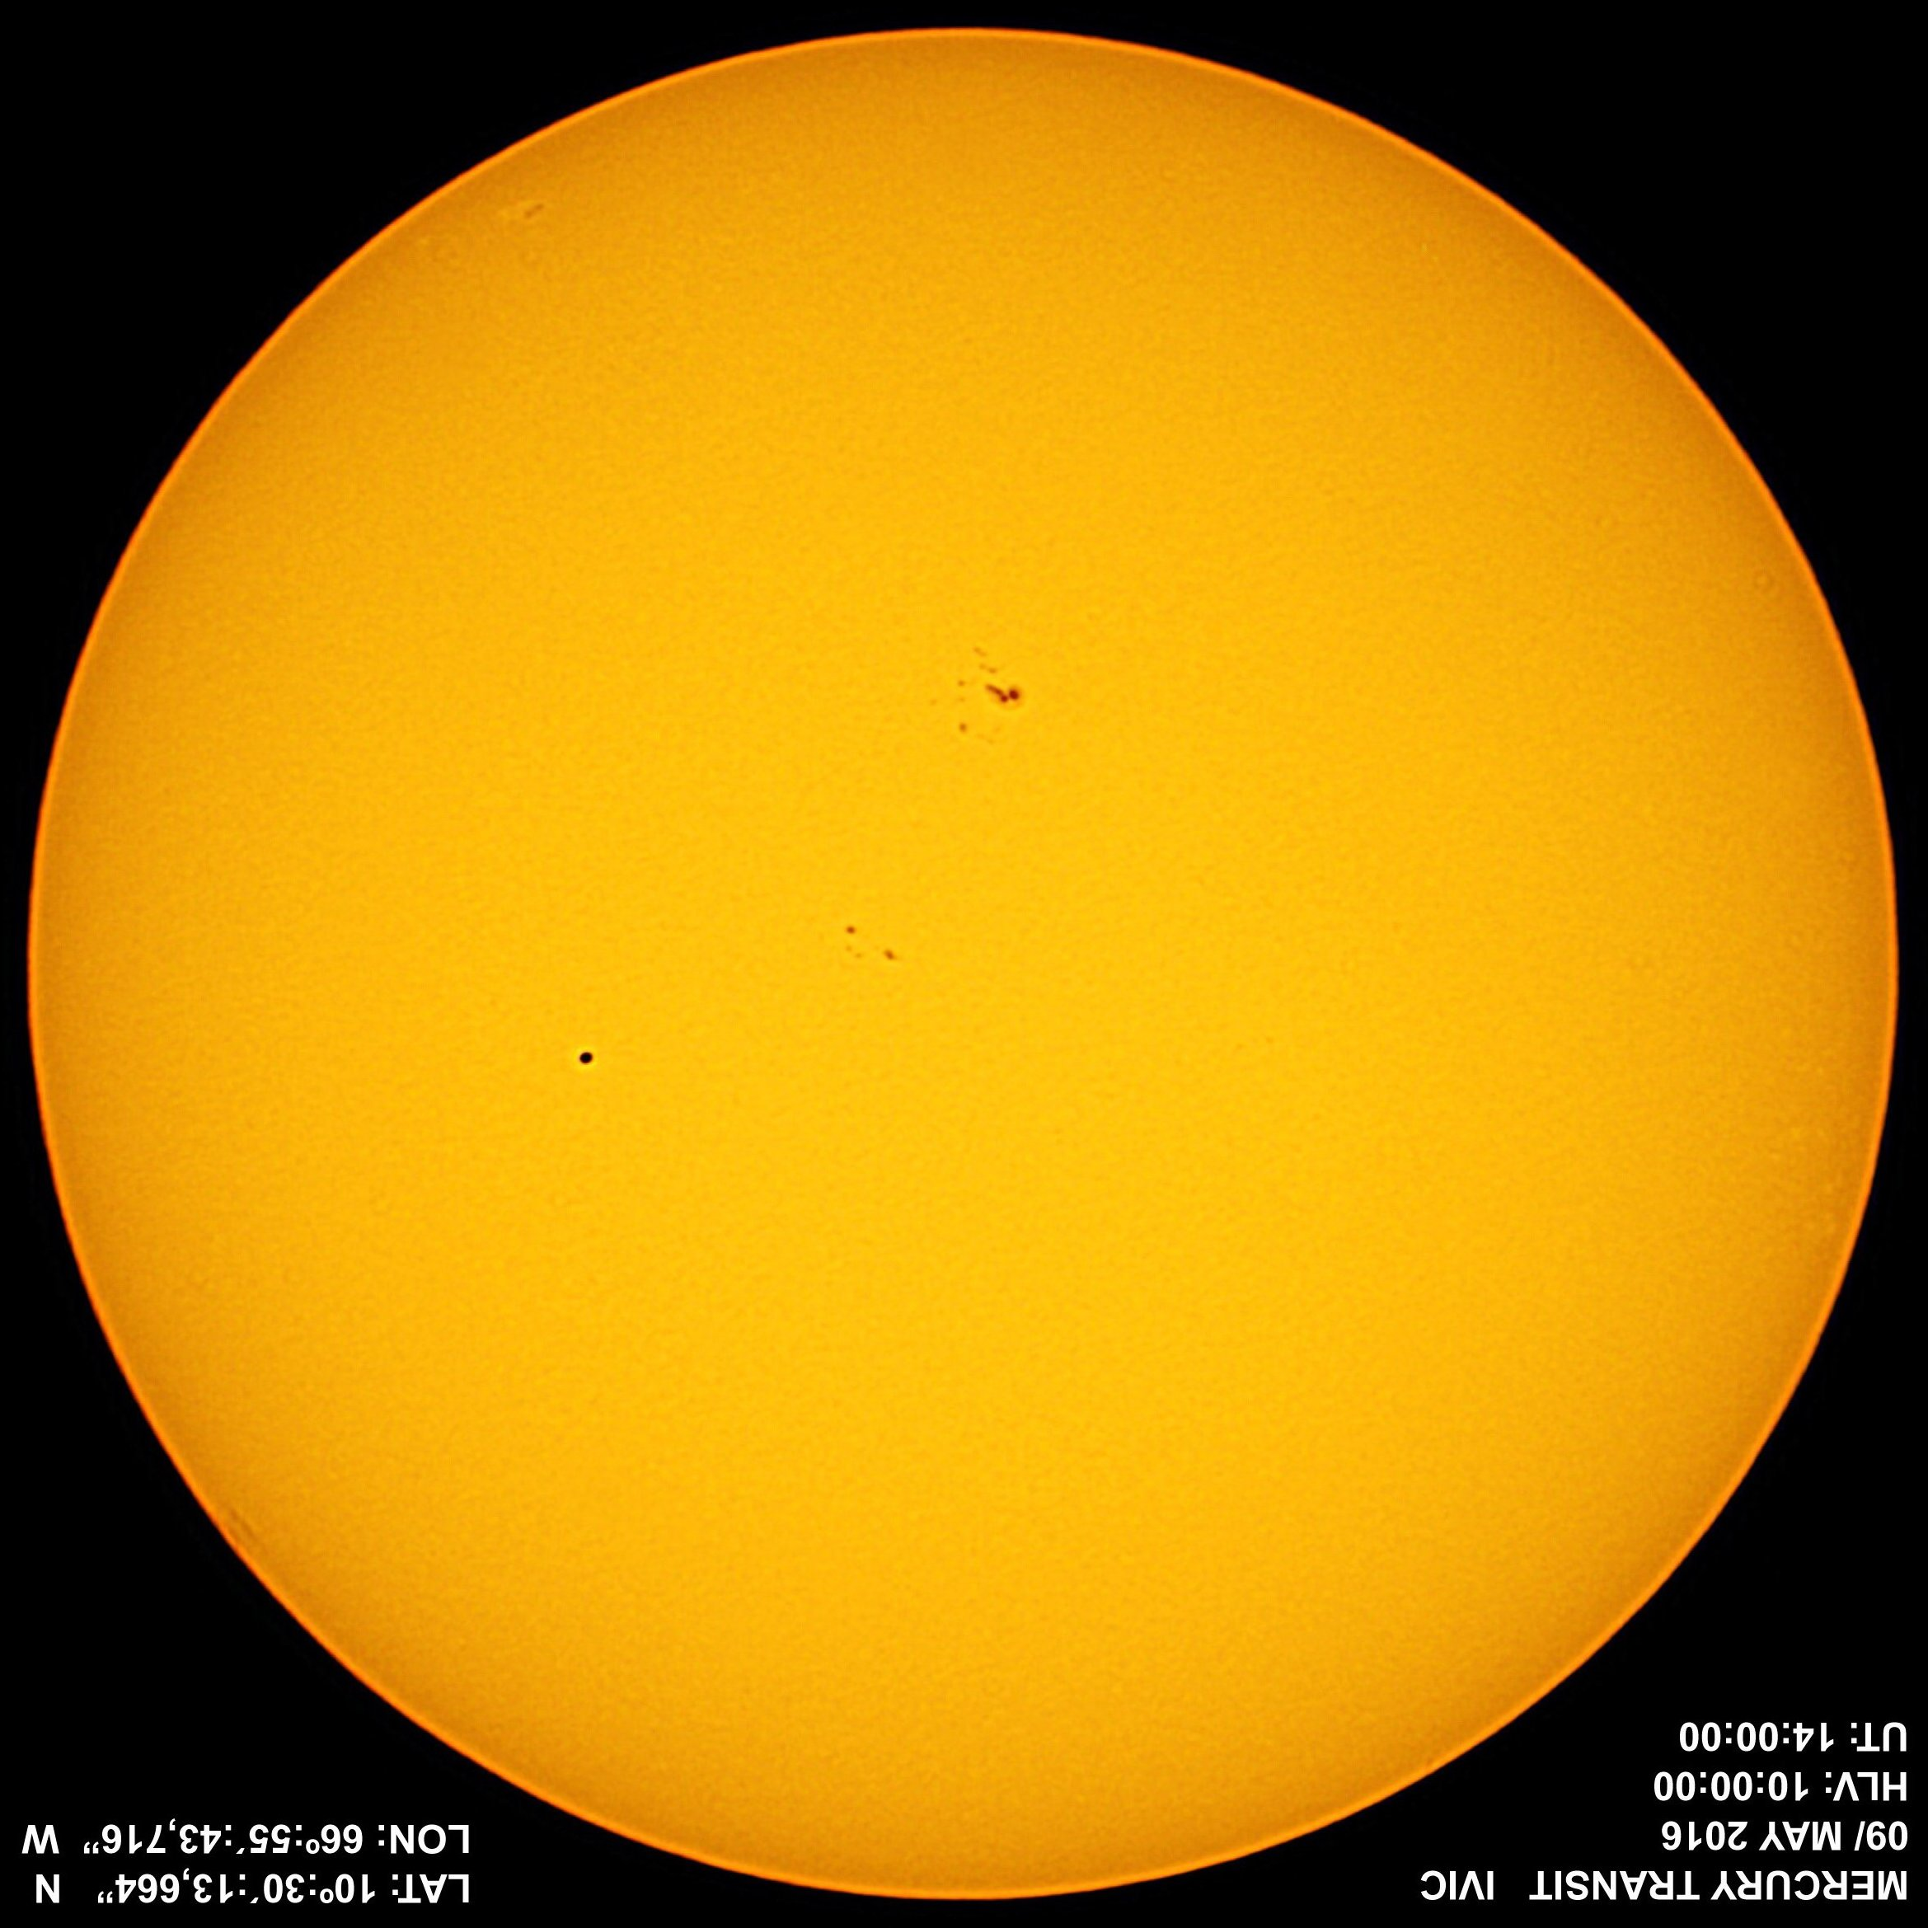
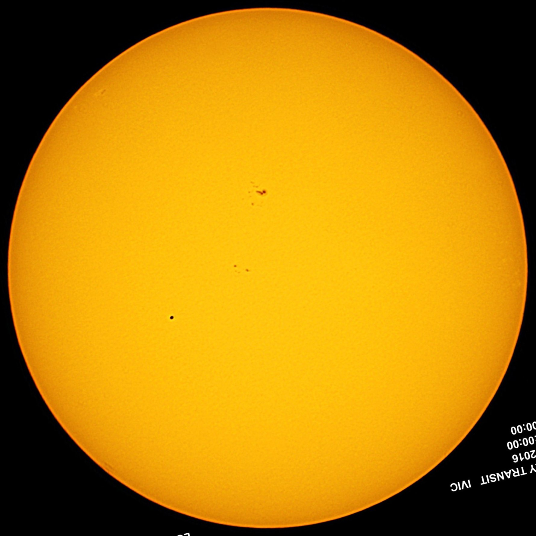
Most of the participants took photos showing the complete solar disc. Those pictures could be oriented by always taking two pictures with fixed cameras or by using a prominent sunspot (though there probably won‘t be a sunspot this year). Examples:

Slide 13
Mercury‘s parallactic shift between
Caracas, Venezuela, and Hannover, Germany
Result of evaluation:
The solar parallax is π_{S}=8.9“, its average distance from the Earth,
the astronomical unit, is 1au=147819000km (which is too small by about 1.2%.
Comparisons between the best photos taken with best coincidence in time yielded a solar parallax of 8.9“ ± 0.4 “ or an astronomical unit of (147.8 ± 6.6) million km.

Slide 14

Because this year the parallax effect will be even smaller than in 2016, it will be very demanding to take pictures that are suitable to measure Mercury's position on the solar disc with sufficient accuracy.
Therefore:
We still are looking for additional partners all over the region of visibility,
especially in North America and South America.
We invite interested students, teachers, amateurs
and professionals to contact us via the homepage of the project:
www.transit-of-mercury.de
2016
2019
We offer
the possibility of publishing your own images on the project site,
the chance of finding simultaneously taken images from distant observers and
algorithms and utilities for evaluating combinations of those images.

Slide 15
Resources
Transit sites:
  Fred Espenaks Transit of Mercury 2019 page
  Xavier M. Jubier's Transit of Mercury 2019 page with an excellent Local Circumstances Calculator
  Jay M. Pasachoff‘s page https://sites.williams.edu/pasachoff/2019tom/
  = http://transitofvenus.info
Project sites:
  http://www.venus2012.de/transit-of-mercury2016/
  http://www.transit-of-mercury2019.de
Publications:
  J. M. Pasachoff et al., Using the 2016 Transit of Mercury to Find the Distance to the Sun, The Physics Teacher 55, 137 (2017)
  https://doi.org/10.1119/1.4976653
  U. Backhaus, Die Merkurtransits 2016 und 2019 und die Astronomische Einheit, Astronomie und Raumfahrt 56/3-4, 26 (2019) (in German) http://www.didaktik.physik.uni-due.de/~backhaus/publicat/
  Merkurtransits2016-19(A+R).pdf
  U. Backhaus, The Transit of Mercury: November 11, 2019, to be published in American Journal of Physics 87/9 or 10 (2019)

Slide 16
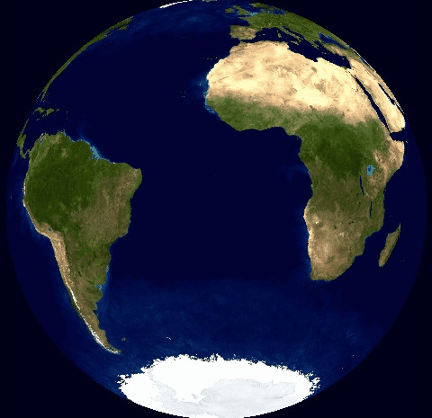
back

