Slide 1
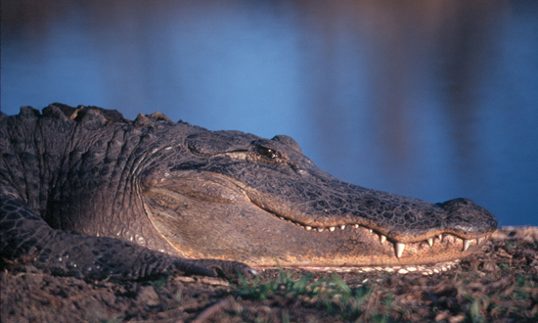
Family Weekend 2006
Things that are both thus and so
Bernhard Klingenberg
Dept. of Math & Stats
Williams College
Stat Lite: Great Taste…Less Filling!
Bernhard Klingenberg
Dept. of Mathematics and Statistics
Williams College

Slide 2
Q: Do you think your partner is responsible to ask about safer sex? (Yes, No)
Yes & Female
No & Female
Yes & Male
No & Male

Slide 3
Result: 2 x2 Table
 | Yes | No
Female
Male
Notation: Contingency or Cross-classification Table
Goal: Summarize and describe association

Slide 4
Early Attempts on Describing “Association”
“Having given the number of instances respectively in which things are both thus and so, in which they are thus but not so, in which they are so but not thus and in which they are neither thus nor so, it is required to eliminate the general quantitative relativity inhering in the mere thingness of the things, and to determine the special quantitative relativity subsisting between the thusness and the soness of the things.”
M. H. Doolittle (1887), cited in Goodman and Kruskal (1979)

Slide 5
Several Ways of Obtaining 2 x 2 Table
 | A | B
I
II
 | A | B
I
II
 |  |  | n
Nothing Fixed
(Poisson Sampling)
Total Sample Size Fixed
(Multinomial Sampling)
 | A | B
I |  |  | n1
II |  |  | n2
 | A | B
I
II
 | m1 | m2
Row Margins Fixed
(Product Binomial Sampling)
Column Margins Fixed
(Case-Control Studies)

Slide 6
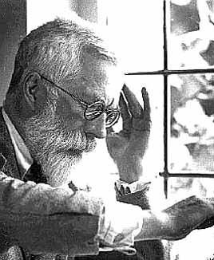
One More Option: Fisher’s Exact Test
 |  | A | B
 | I |  |  | n₁
 | II |  |  | n₂
 |  | m₁ | m₂ | n
 |  | Guess
 |  | Milk | Tea
Truth | Milk |  |  | 4
 | Tea |  |  | 4
 |  | 4 | 4 | 8
3
1
All Margins Fixed
(Hypergeometric Sampling)
1
3
Sir Ronald Fisher (1890-1962)
Do these data provide evidence that Dr. Bristol has the ability to distinguish what was poured first?

Slide 7
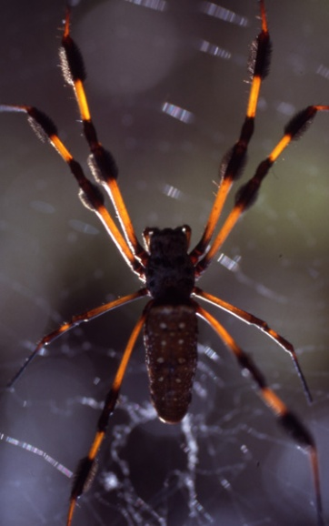
All possible tables
 | Truth
Guess | Milk | Tea | Total
Milk | 0 | . | 4
Tea | . | . | 4
Total | 4 | 4 | 8
 | Truth
Guess | Milk | Tea | Total
Milk | 1 | . | 4
Tea | . | . | 4
Total | 4 | 4 | 8
 | Truth
Guess | Milk | Tea | Total
Milk | 2 | . | 4
Tea | . | . | 4
Total | 4 | 4 | 8
 | Truth
Guess | Milk | Tea | Total
Milk | 3 | . | 4
Tea | . | . | 4
Total | 4 | 4 | 8
 | Truth
Guess | Milk | Tea | Total
Milk | 4 | . | 4
Tea | . | . | 4
Total | 4 | 4 | 8

Slide 8
Probability Distribution?
# correct guesses | # instances (out of 70) | Probability assuming we are just guessing and have no ability to distinguish
0 | 1 | 1 / 70 = 0.014
1 | 16 | 16 / 70 = 0.229
2 | 36 | 36 / 70 = 0.514
3 | 16 | 16 / 70 = 0.229
4 | 1 | 1 / 70 = 0.014
 | 70 | 1
Fact: The number of correct guesses follows the hypergeometric distribution

Slide 9
Convinced?
Chances of obtaining a high number of correct guesses by simply guessing must be small
Here, only the case where one gets 4 correct guesses is convincing
If you just randomly guessed, you get 4 correct 14 times out of a 100. That’s rather unlikely (but not impossible), so it does give some credibility to your claim.

Slide 10
P-value for Fisher’s Exact Test
What is the P-value for testing independence?
How likely is it to observe the table we have observed, or a more extreme one, given there is no association (i.e., one is just guessing).
How do we measure extremeness? Several options:
Based on table null probabilities (the smaller (!), the more evidence for an association)
Based on tables that result in first cell count (or odds ratio) as large or larger than observed (only for 2x2 tables)
Based on Chi-square statistic (the larger, the more evidence for the alternative)

Slide 11
P-value for Fisher’s Exact Test
Using table null probabilities as criterion:
where the sum is over all tables that have null probability as small or smaller than observed table.
Milk vs. Tea: H₀: no association (independence) vs. H_{A}: a positive association
P-value = 0.014 if we observed 4 correct guesses
P-value = 0.014 + 0.229 = 0.243 if we observed 3 correct guesses

Slide 12
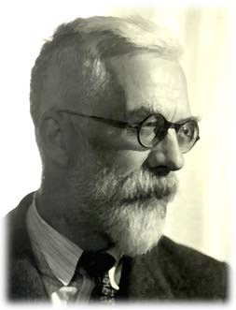
Fisher’s Exact Test
The procedure we just went through is called Fisher’s Exact Test (1935) and has applications in Genetics, Biology, Medicine, Agri-culture, Psychology, Business,…
Sir Ronald Fisher
(1890-1962)

Slide 13
Class Experiment
 |  | Truth
 |  | Diet | Zero
Guess | Diet |  |  | 5
 | Zero |  |  | 5
 |  | 5 | 5 | 10

Slide 14
How many correct guesses?
Out of 10 cups: 5 with Diet, 5 with Zero
# correct guesses | # instances (out of 252) | Probability
0 | 1 | 1 / 252 = 0.0040
1 | 25 | 25 / 252 = 0.0992
2 | 100 | 100 / 252 = 0.3968
3 | 100 | 100 / 252 = 0.3968
4 | 25 | 25 / 252 = 0.0992
5 | 1 | 1/252 = 0.0040
 | 252 | 1

Slide 15
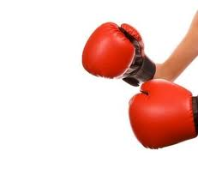
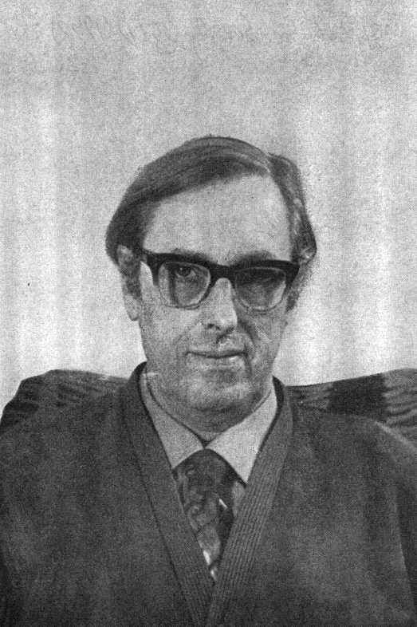
Fisher’s Exact Test
Round 1: Fisher vs. Barnard
Barnard (1945,1947): Fishers Exact Test too restrictive. Only fix row margins.
“The fact that such an unhelpful outcome as these might occur […] is surely no reason for enhancing our judgment of significance in cases where it has not occurred.” (Fisher, 1945)
Fisher
Barnard
(1915-2002)
Barnard, in 1949, retracted his proposal in favor of Fisher’s.
Today: Still undecided, but generally Barnard’s approach is preferred. (There is also a nice compromise: mid P-values)
In any case: Prefer confidence intervals to P-values

Slide 16
Back to Describing Association
Several Measures for Association:
Difference of Proportion:
(y₁/n₁) – (y₂/n₂)
Ratio of Proportion:
(y₁/n₁) / (y₂/n₂)
Odds Ratio:
[ (y₁/n₁) / ( 1 - y₁/n₁) ] / [ (y₂/n₂) / (1 - y₂/n₂ ) ]
 | M | V
F | y₁ |  | n₁
M | y₂ |  | n₂

Slide 17
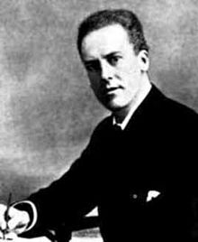
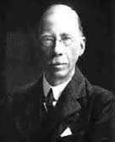
Describing Association
Round 2: Pearson vs. Yule
Yule proposed the Odds Ratio to measure association in 2x2 tables
Pearson, who had previously “invented” the correlation coefficient (r) for quantitative data proposed a similar measure for 2x2 tables: Tetrachoric Correlation
Karl Pearson
(1857 – 1936)
Udyn Yule
(1871 – 1951)

Slide 18
Describing Association
Round 2: Pearson vs. Yule
Yule’s reaction to Pearson’s suggestion:
“At best the normal coefficient can only be said to give us in cases like these a hypothetical correlation between supposititious variables. The introduction of needless and unverifiable hypotheses does not appear to me to be desirable proceeding in scientific work. “
Udyn Yule
(1871 – 1951)

Slide 19
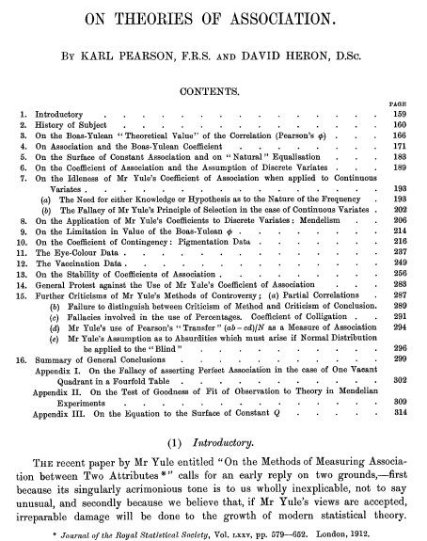
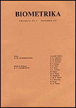
Pearson’s reply:

Slide 20
Describing Association
Pearson continues:
“We regret having to draw attention to the manner in which Mr Yule has gone astray at every stage in his treatment of association…[He needs to withdraw his ideas] if he wishes to maintain any reputation as a statistician.”
Today: Odds Ratio predominant measure, especially in clinical trials. Drawback: Hard to interpret.

Slide 21
Describing Association
Round 3: Pearson vs. Fisher
In 1900, Pearson introduced the Chi-square test for independence
He claimed that for 2x2 tables the degrees of freedom for the test should be df=3.
Fisher (1922) showed that instead they should be df=1.

Slide 22
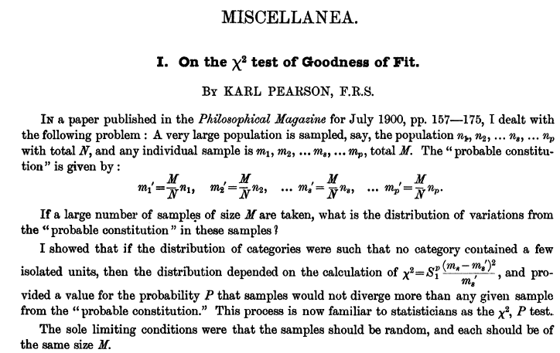
Describing Association
Round 3: Pearson vs. Fisher
Pearson was not amused:

Slide 23
Describing Association
Round 3: Pearson vs. Fisher
Fisher was unable to get his reply published and later wrote:
“[My 1922 paper] had to find its way to publication past critics who, in the first place, could not believe that Pearson’s work stood in need of correction, and who, if this had to be admitted, were sure that they themselves had corrected it.”

Slide 24
Describing Association
Round 3: Pearson vs. Fisher
And about Pearson:
“If peevish intolerance of free opinion in others is a sign of senility, it is one which he had developed at an early age.”
Today: The df for the Chi-Squared test in 2x2 tables are 1, and more generally for IxJ tables, df=(I-1)(J-1)

Slide 25
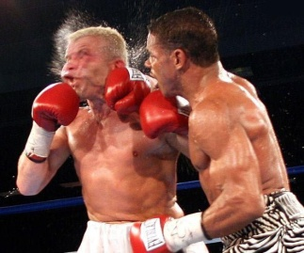
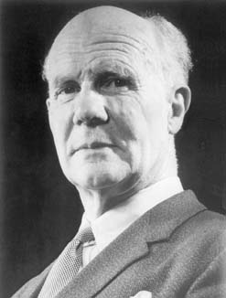
Describing Association
Knockout: Pearson vs. Fisher
In 1926, Fisher analyzed 11,688 2x2 tables generated by Pearson’s son (Egon Pearson) under the assumption of independence
Fact: If independence holds, the value of the Chi-square statistic should be close to the df.
Fisher showed that the mean of the Chi-square statistic for these tables is 1.00001
Egon Pearson
(1895 – 1980)

Slide 26
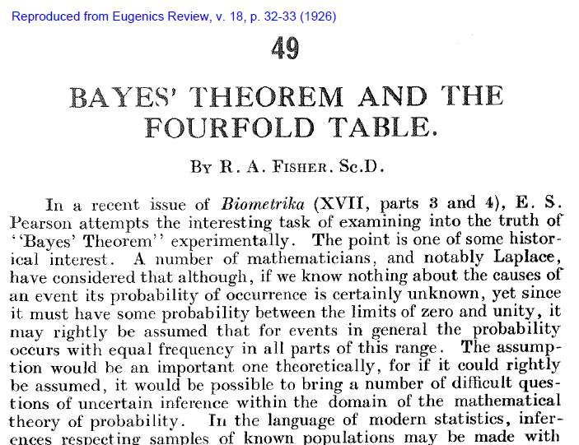

Slide 27
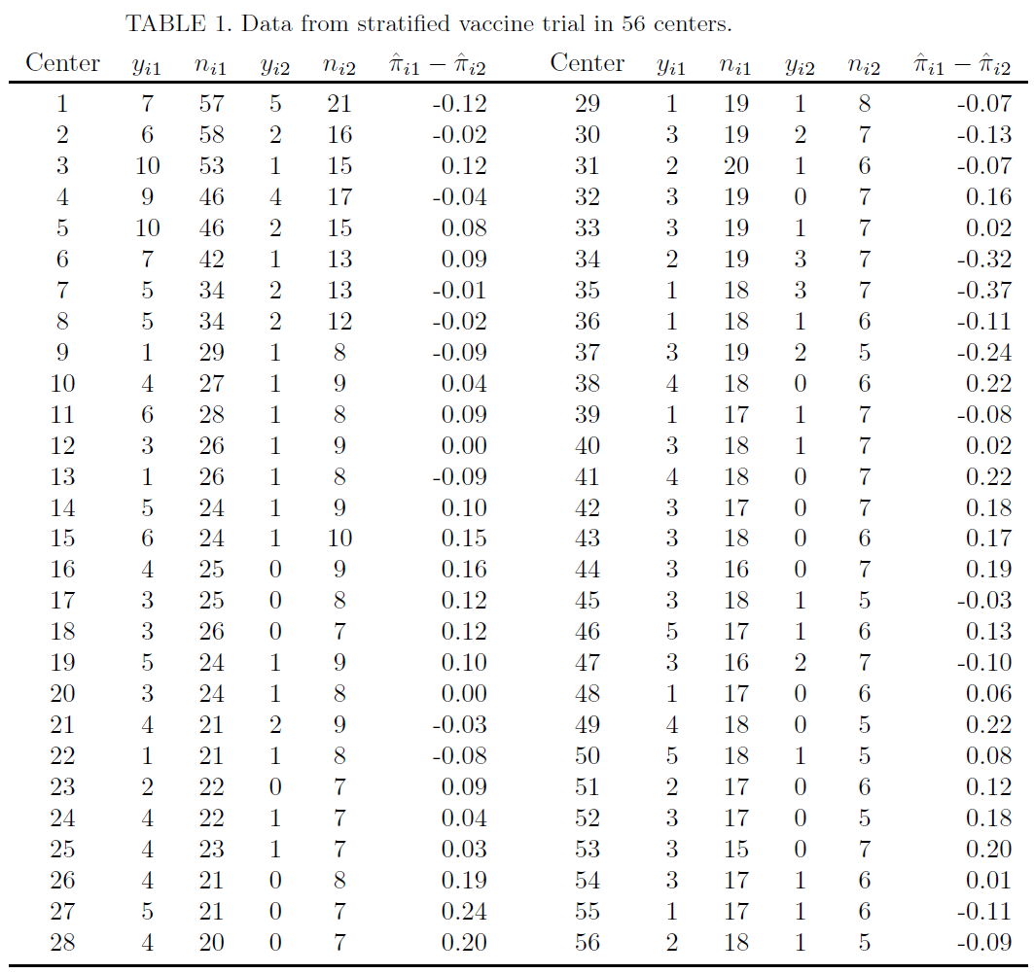
Research today
Several 2x2 tables:

Slide 28
Research today
Suppose you are measuring two binary features on the same subject (i.e., whether or not a patient experiences Abdominal Pain or Headache)
Do this in two groups (i.e., Treatment vs. Control). Interested if the (marginal) probability of Pain and of Headache differs between the two groups.
Group 1 Group 2
Headache
Headache
 | No | Yes
No
Yes
 | No | Yes
No
Yes
Pain
Pain

